Slide 1
Lecture 6-2
Softmax classification:
softmax and cost function
Sung Kim <hunkim+mr@gmail.com>
http://hunkim.github.io/ml/

Slide 2
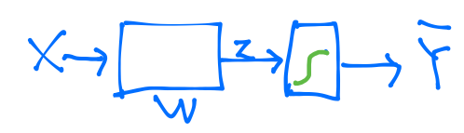
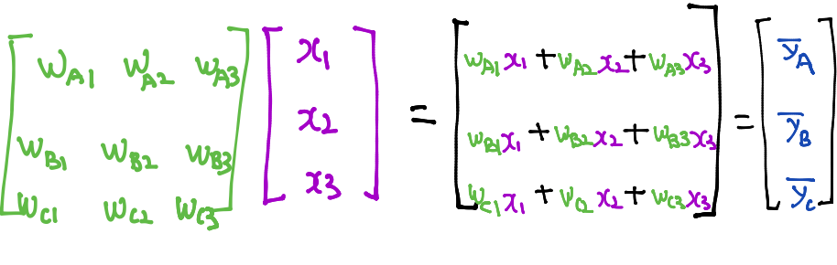
Where is sigmoid?

Slide 3
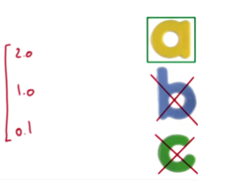
Where is sigmoid?

Slide 4
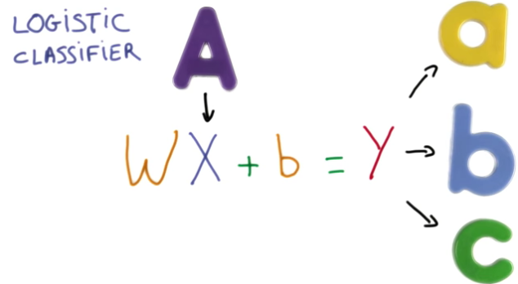

Slide 5
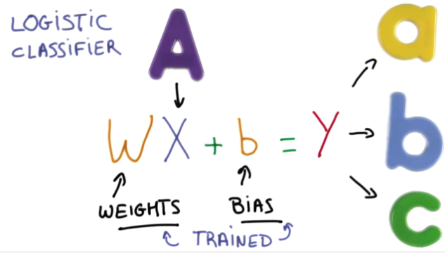

Slide 6
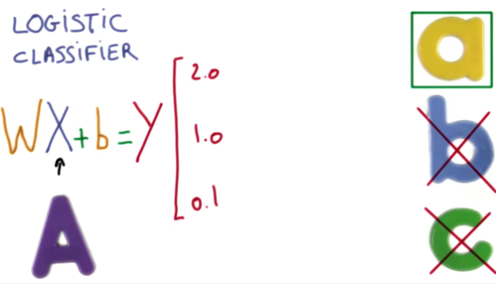

Slide 7
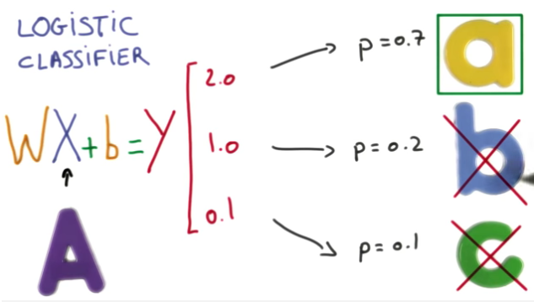
Sigmoid?
https://www.udacity.com/course/viewer#!/c-ud730/l-6370362152/m-6379811817

Slide 8
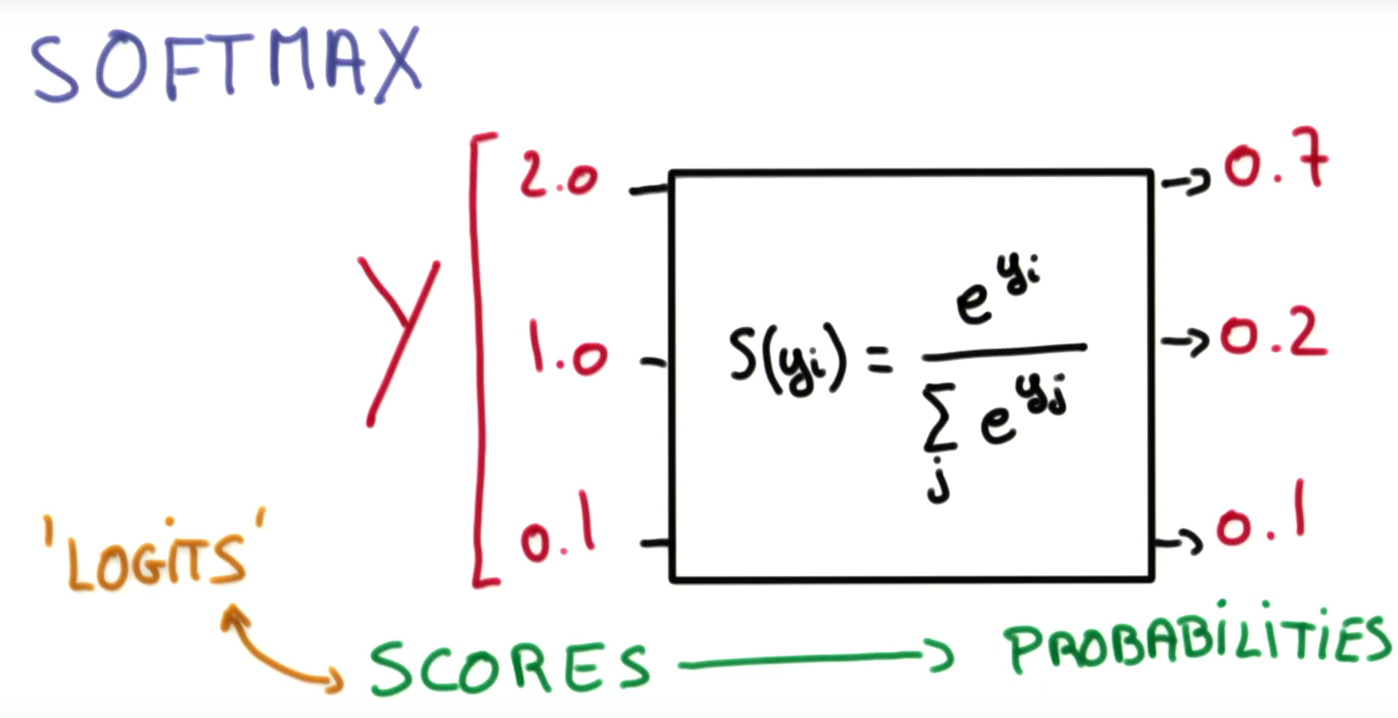
https://www.udacity.com/course/viewer#!/c-ud730/l-6370362152/m-6379811817

Slide 9
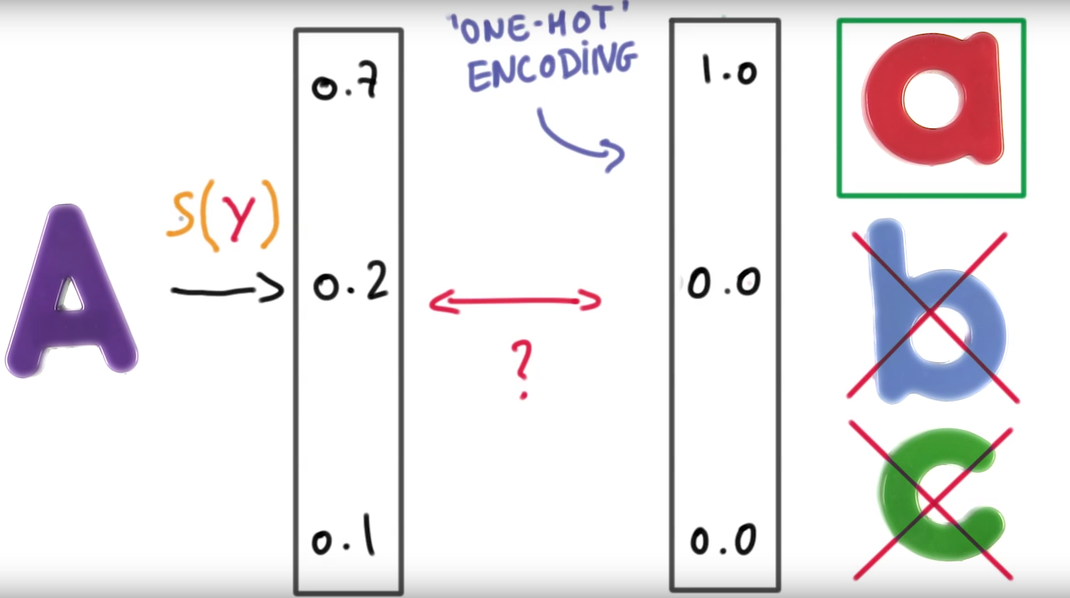
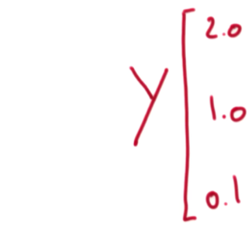
https://www.udacity.com/course/viewer#!/c-ud730/l-6370362152/m-6379811817

Slide 10
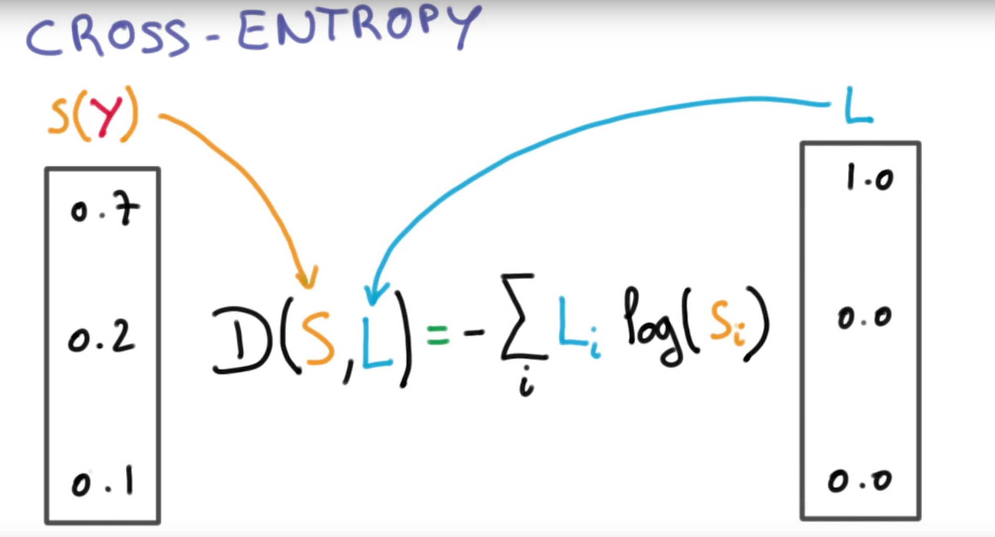
Cost function
https://www.udacity.com/course/viewer#!/c-ud730/l-6370362152/m-6379811817

Slide 11
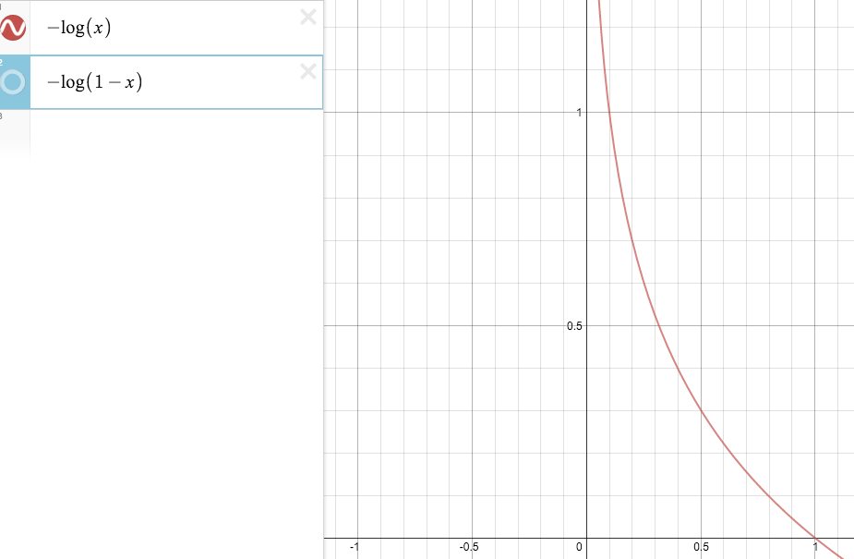
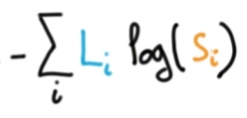
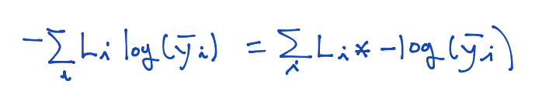
Cross-entropy cost function

Slide 12
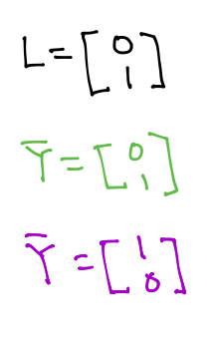
Cross-entropy cost function

Slide 13
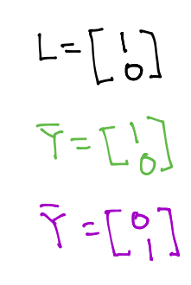
Cross-entropy cost function

Slide 14
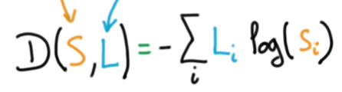
Logistic cost VS cross entropy
c

Slide 15
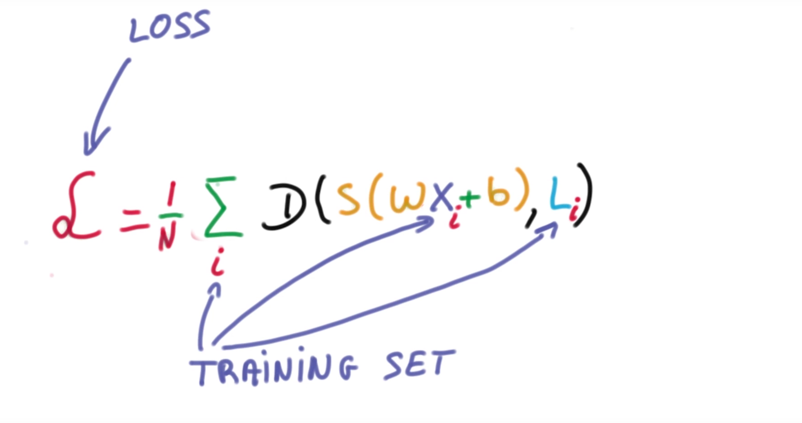
Cost function
https://www.udacity.com/course/viewer#!/c-ud730/l-6370362152/m-6379811817

Slide 16
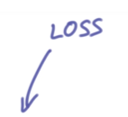
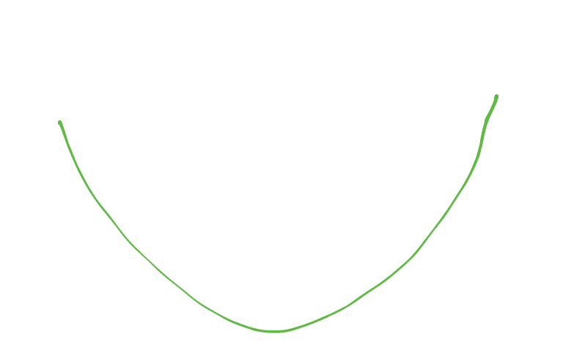
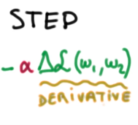
Gradient descent
https://www.udacity.com/course/viewer#!/c-ud730/l-6370362152/m-6379811827

Slide 17

Next
Applications & Tips

